Slide 1
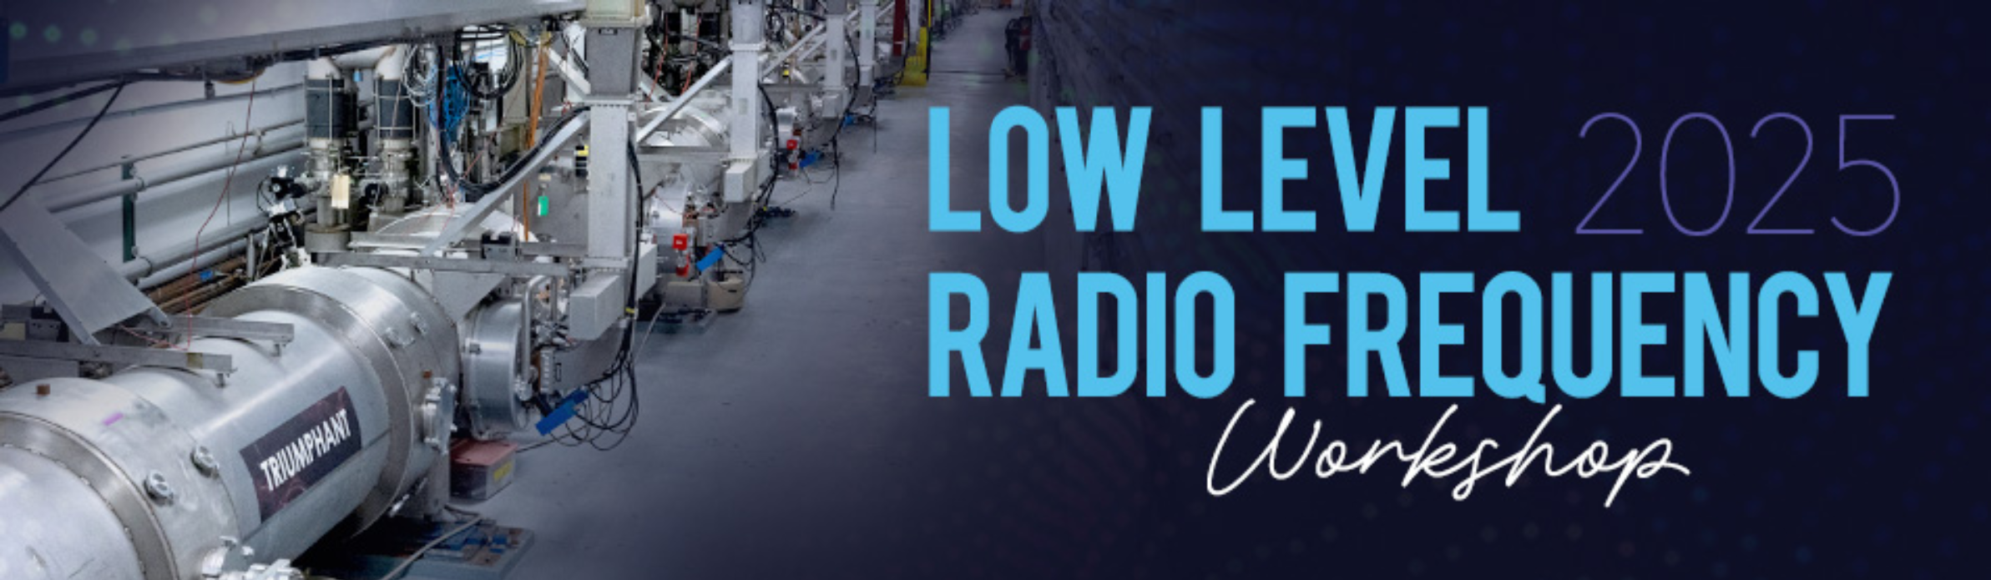
Master Oscillator and Phase Reference Line Design for the PIP-II Linac
FERMILAB-SLIDES-25-0272-AD
October 2025
Low Level Radio Frequency Workshop (LLRF Workshop October 2025)
Ahmed Syed
E. Cullerton, Dr. B. Vaughn, Dr. P. Varghese, D. Pieper, S. Stevenson, R. Madrak, D. Klepec

Slide 2
Agenda
Introduction
Purpose
Design Theory
Simulation
Performance & Testing
Construction and Assembly
Literature/ References

Slide 3
Introduction
System Core
Operates from a single 162.5 MHz low-noise oscillator (Wenzel 10 MHz& 162.5 MHz Vibration-Isolated MXO-PLMX Plate ).
Key Functions
Provides phase-stable reference signals at 162.5 MHz, 325 MHz, and 650 MHz to LLRF racks in each linac section.
Distributes LO signals at 182.5 MHz, 345 MHz, and 670 MHz to LLRF racks in the corresponding linac sections.
Supplies 1320 MHz clock signals to all LLRF racks throughout the linac.
Notes:
The reference line operates from a single 162.5 MHz Wenzel master oscillator mounted on a vibration-isolated plate.
It provides exceptional phase-noise and frequency stability, crucial for PIP-II timing.
The system distributes RF reference signals to each LINAC section and provides LO and clock signals—1320 MHz and 1300 MHz—for the LLRF electronics.

Slide 4

System Operation
Design goals :
Relative Phase Stability: The system must maintain a stable relative phase between stations, as variations can arise from long cable runs and environmental factors like thermal expansion and contraction of cables.
Absolute Phase Drift: The system must also minimize absolute phase drift to ensure the long-term stability of the reference signals.
Forward-Reflected Phase Aggregation
A forward signal is sent down the reference line and a reverse signal is created by a short termination. Both signals are sampled at each station.
Averaging the forward and reverse signals makes the combined phase invariant to changes in cable length.
In theory: The output phase at each station remains stable, dependent only on the master oscillator's phase, not the length of the cables.
Notes:
Important tasks on hand are to ensure the relative phase between stations is stable over entire linac lengths and independent of changes in temperature,
Next to ensure the absolute phase drift.
Phase stability is achieved through a forward–reverse phase-averaging technique.
At each directional coupler, the forward and reflected waves combine so that their sum becomes invariant to cable-length changes.
If the coupler amplitudes are perfectly matched, the output phase remains constant even when cables expand or contract.

Slide 5
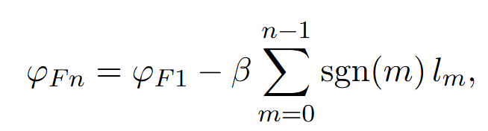
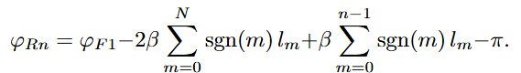
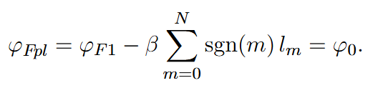
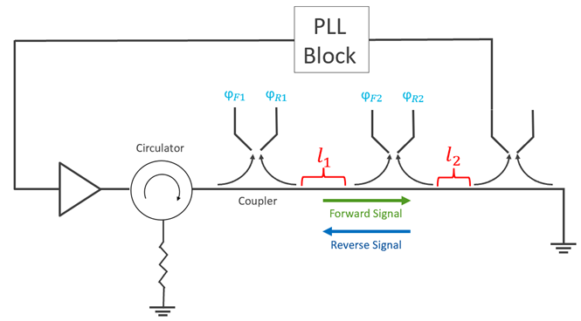
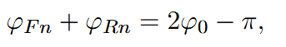
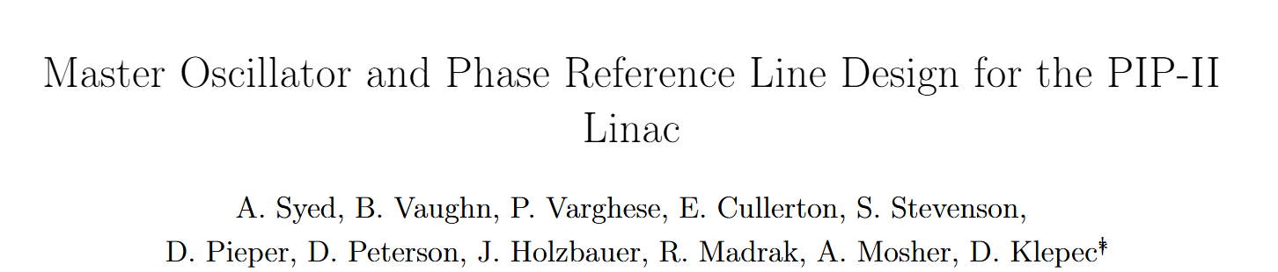
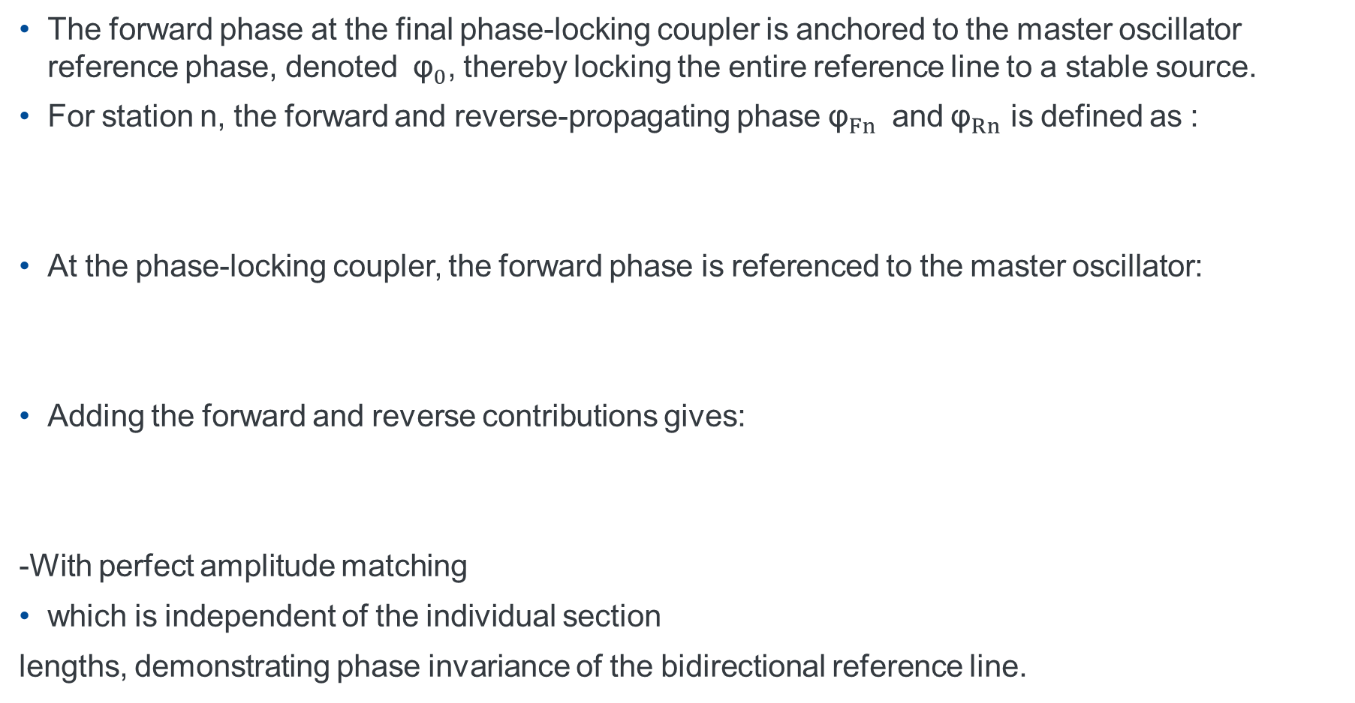
Forward-Reflected Phase Invariance
The forward phase at the final phase-locking coupler is anchored to the master oscillator reference phase, denoted ${\text{φ}}_{0}$, thereby locking the entire reference line to a stable source.
For station n, the forward and reverse-propagating phase ${\text{φ}}_{Fn}$ and ${\text{φ}}_{Rn}$ is defined as :
At the phase-locking coupler, the forward phase is referenced to the master oscillator:
Adding the forward and reverse contributions gives:
-With perfect amplitude matching
which is independent of the individual section
lengths, demonstrating phase invariance of the bidirectional reference line.
Notes:
The key technique is the forward-reverse phase invariance. Forward and reverse phase equations are shown as on the screen. The reflected wave travels all the way to the short gets reflected and loops back hence we see the terms in

Slide 6
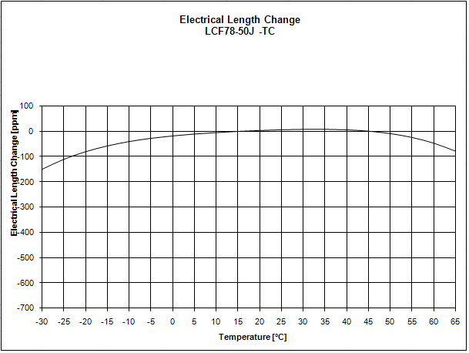
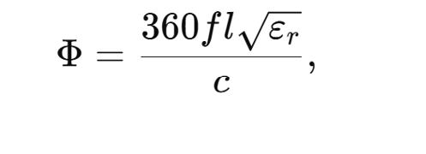
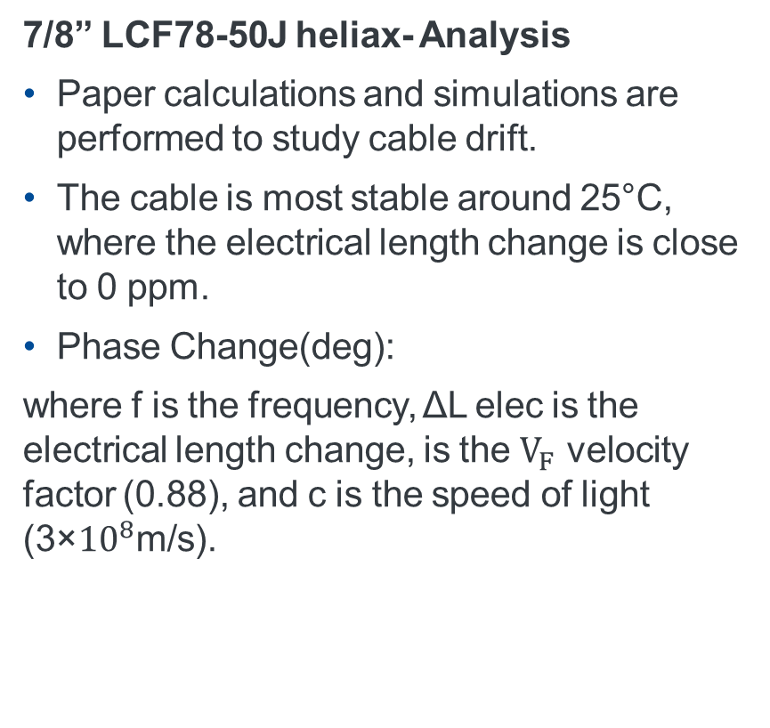
Thermal Expansion of Cables
7/8” LCF78-50J heliax- Analysis
Paper calculations and simulations are performed to study cable drift.
The cable is most stable around 25°C, where the electrical length change is close to 0 ppm.
Phase Change(deg):
where f is the frequency, ΔL elec​ is the electrical length change, is the $V_{F}$ velocity factor (0.88), and c is the speed of light (3×${10}^{8}$m/s).
Frequency (MHz) | Wavelength (m) | Phase Delay (ns) | Electrical Length Change (ppm) | Temperature Change (°C) | Electrical Length Change (m) | Delay Change (ps) | Phase Change (°)
162.5 | 1.85 | 37.5 | 10 | 25 to 50 deg C | 0.0001 | 0.375 | 0.02
325 | 0.92 | 37.5 | 10 | 25 to 50 deg C | 0.0001 | 0.375 | 0.04
650 | 0.46 | 37.5 | 10 | 25 to 50 deg C | 0.0001 | 0.375 | 0.08
1300 | 0.23 | 37.5 | 10 | 25 to 50 deg C | 0.0001 | 0.375 | 0.16
*Original cable length 10m
Notes:
We analyze cables by reviewing manufacturer data knowing that’s not a gold standard but just a starting point. A worst case study of ppm deviation for expected temperature range is studied and calculations are made to know the delay change in ps and phase change for a 10 m length of cable at different frequencies.. Next step is to simulate the model.

Slide 7
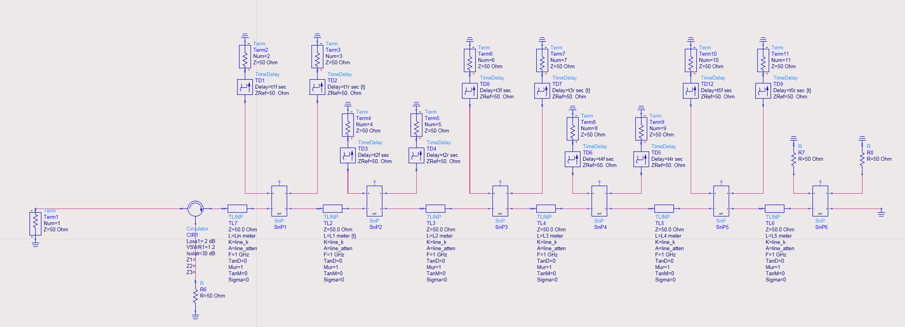

Simulation
Station Coupler
${ T}_{Ln} −$Inter-station Line
Notes:
In the simulation we model the station as shown here is a 162.5MHz using snp files of the real test data of the couplers, circulator and transmission line. This simulation also includes the line lengths between stations to be that of the linac spacing. The intent is to analyze performance and predict non ideal behavior. We will talk about the results.

Slide 8
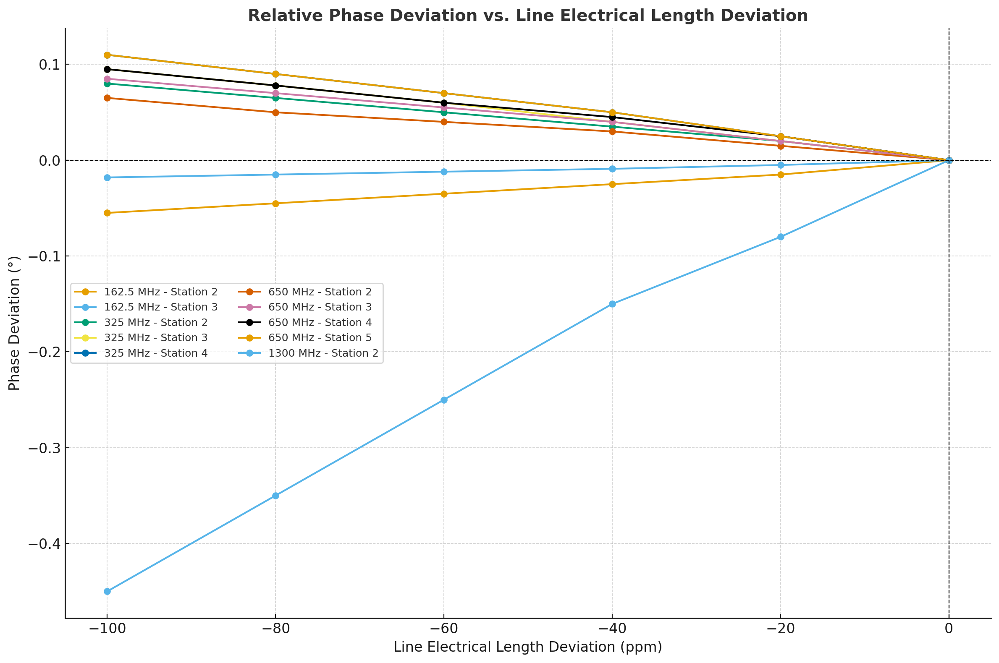
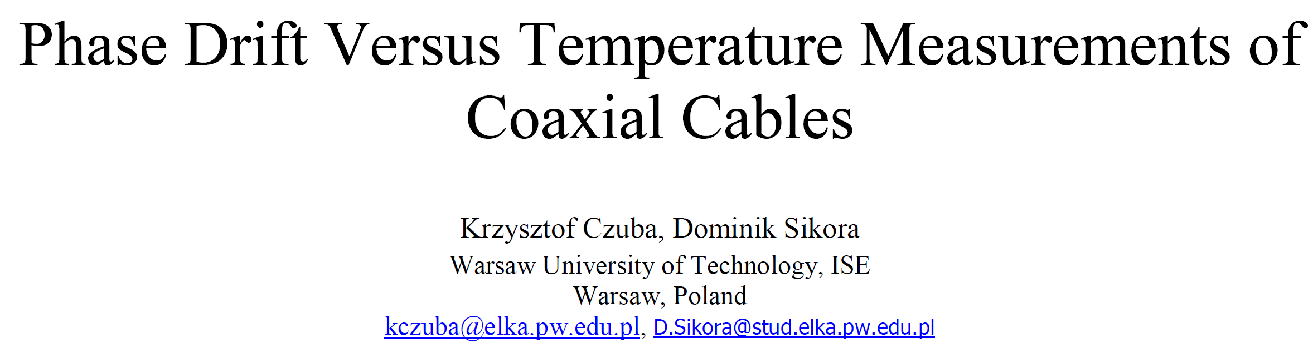
Thermal Expansion Simulation
In order to simulate the effect of thermal variation, for each line, the electrical length is decreased in several steps and the phase difference is tracked between station 1 and each subsequent station.
Note all coaxial cables in each line are decreased by the same proportion. The nominal phase differences relative to station 1 are then subtracted from the varying phase differences as the line lengths change to track the phase difference variations.
Notes:
As shown in the previous slide the station lengths are adjusted for each station from station-1 knowing the expected worst case ppm deviation in temperature and factoring the length change to know the phase angle deviation for different frequency stations.

Slide 9
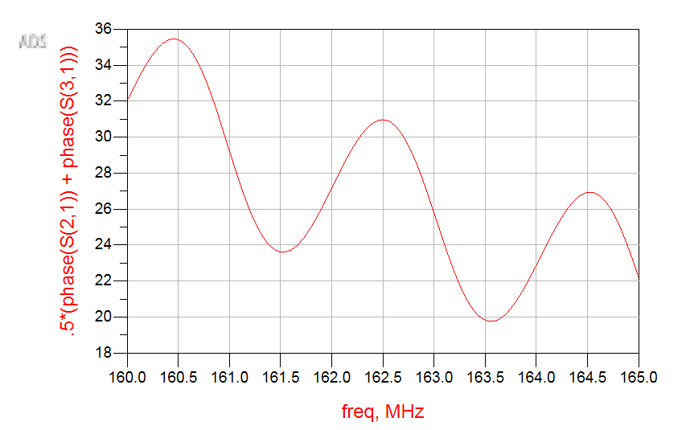
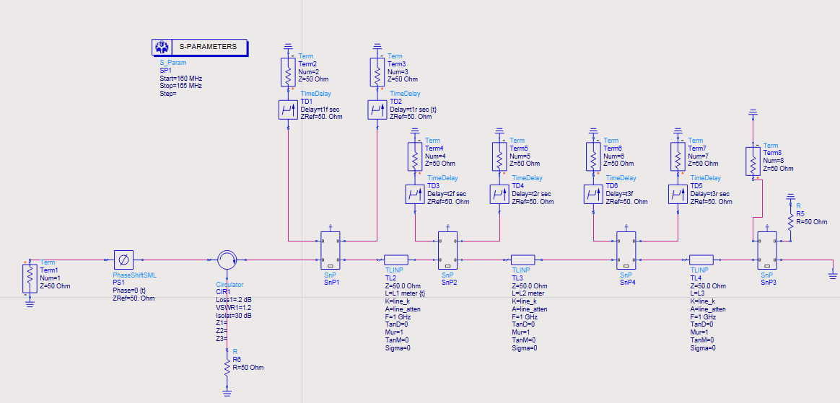
Phase Ripple
Phase equations are exact only if all components are perfectly impedance-matched, which is not the case in practice.
Small mismatches cause a ripple in the line-length (frequency) dependent phase response that is not mitigated by aggregation technique.
Time Delay-Compensated Station 1 Average Phase
162.5 MHz ADS Reference Line Model
Reference –[5]
Notes:
Using the simulated the expected non ideal behaviour of phase ripple in the output summed signal at each coupler tap point is shown on the screen. In order to achieve max stability the differential of phase with respect to time should be zero hence we need to ensure the peak or trough of the phase ripple lines up with the center frequency. The line lengths are tweaked till this is achieaved for all coupler tap points and all stations.

Slide 10
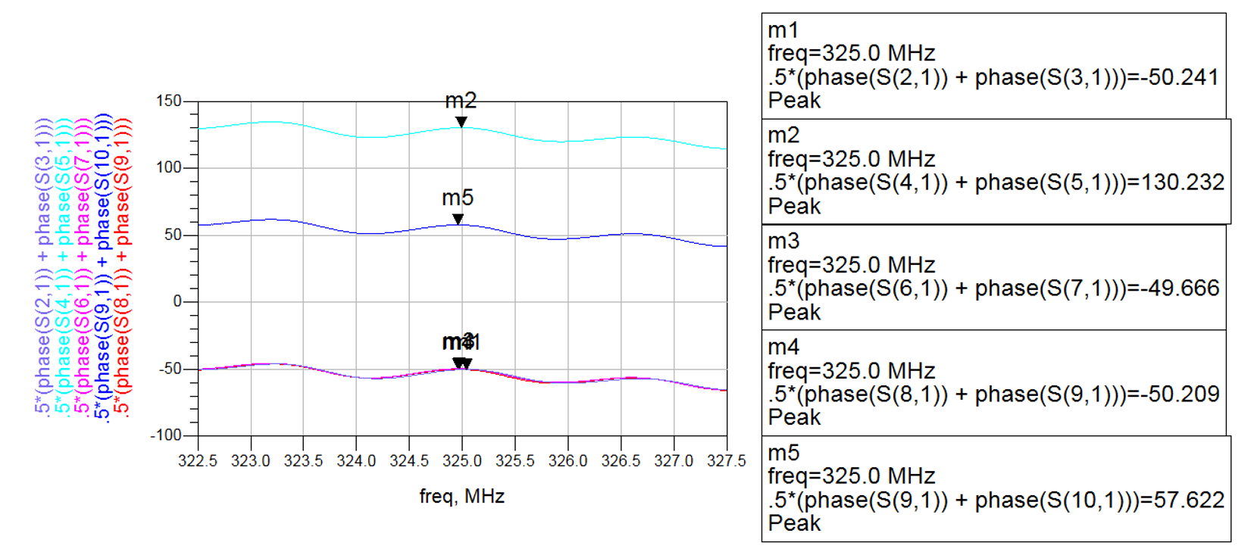
Phase Ripple Adjustment
Inter-station line lengths are tuned such that center frequency is positioned at a ripple peak or trough to minimize ripple effect.
These line lengths are a starting point to start building and testing cables preceding amplitude matching.
Line Frequency (MHz) | L_{in} (m) | L₁ (m) | L₂ (m) | L₃ (m) | L₄ (m) | L₅ (m)
162.5 | 0 | 15.04 | 10 | 40.26 | 0 | 0
325 | 0 | 15.086 | 15.83 | 15.853 | 15.84 | 15.19
650 | 15.10 | 32.76 | 32.76 | 32.76 | 32.76 | 15.10
1300 | 0 | 64.91 | 48.99 | 0 | 0 | 0
Notes:
Following the procedure to adjust the phase ripple we end up with line lengths tweaked to about a 1/00ths of a meter and this is a starting point for us to start building the sections and subject them to some rigorous real world tests to see how much these simulations may have lied.

Slide 11
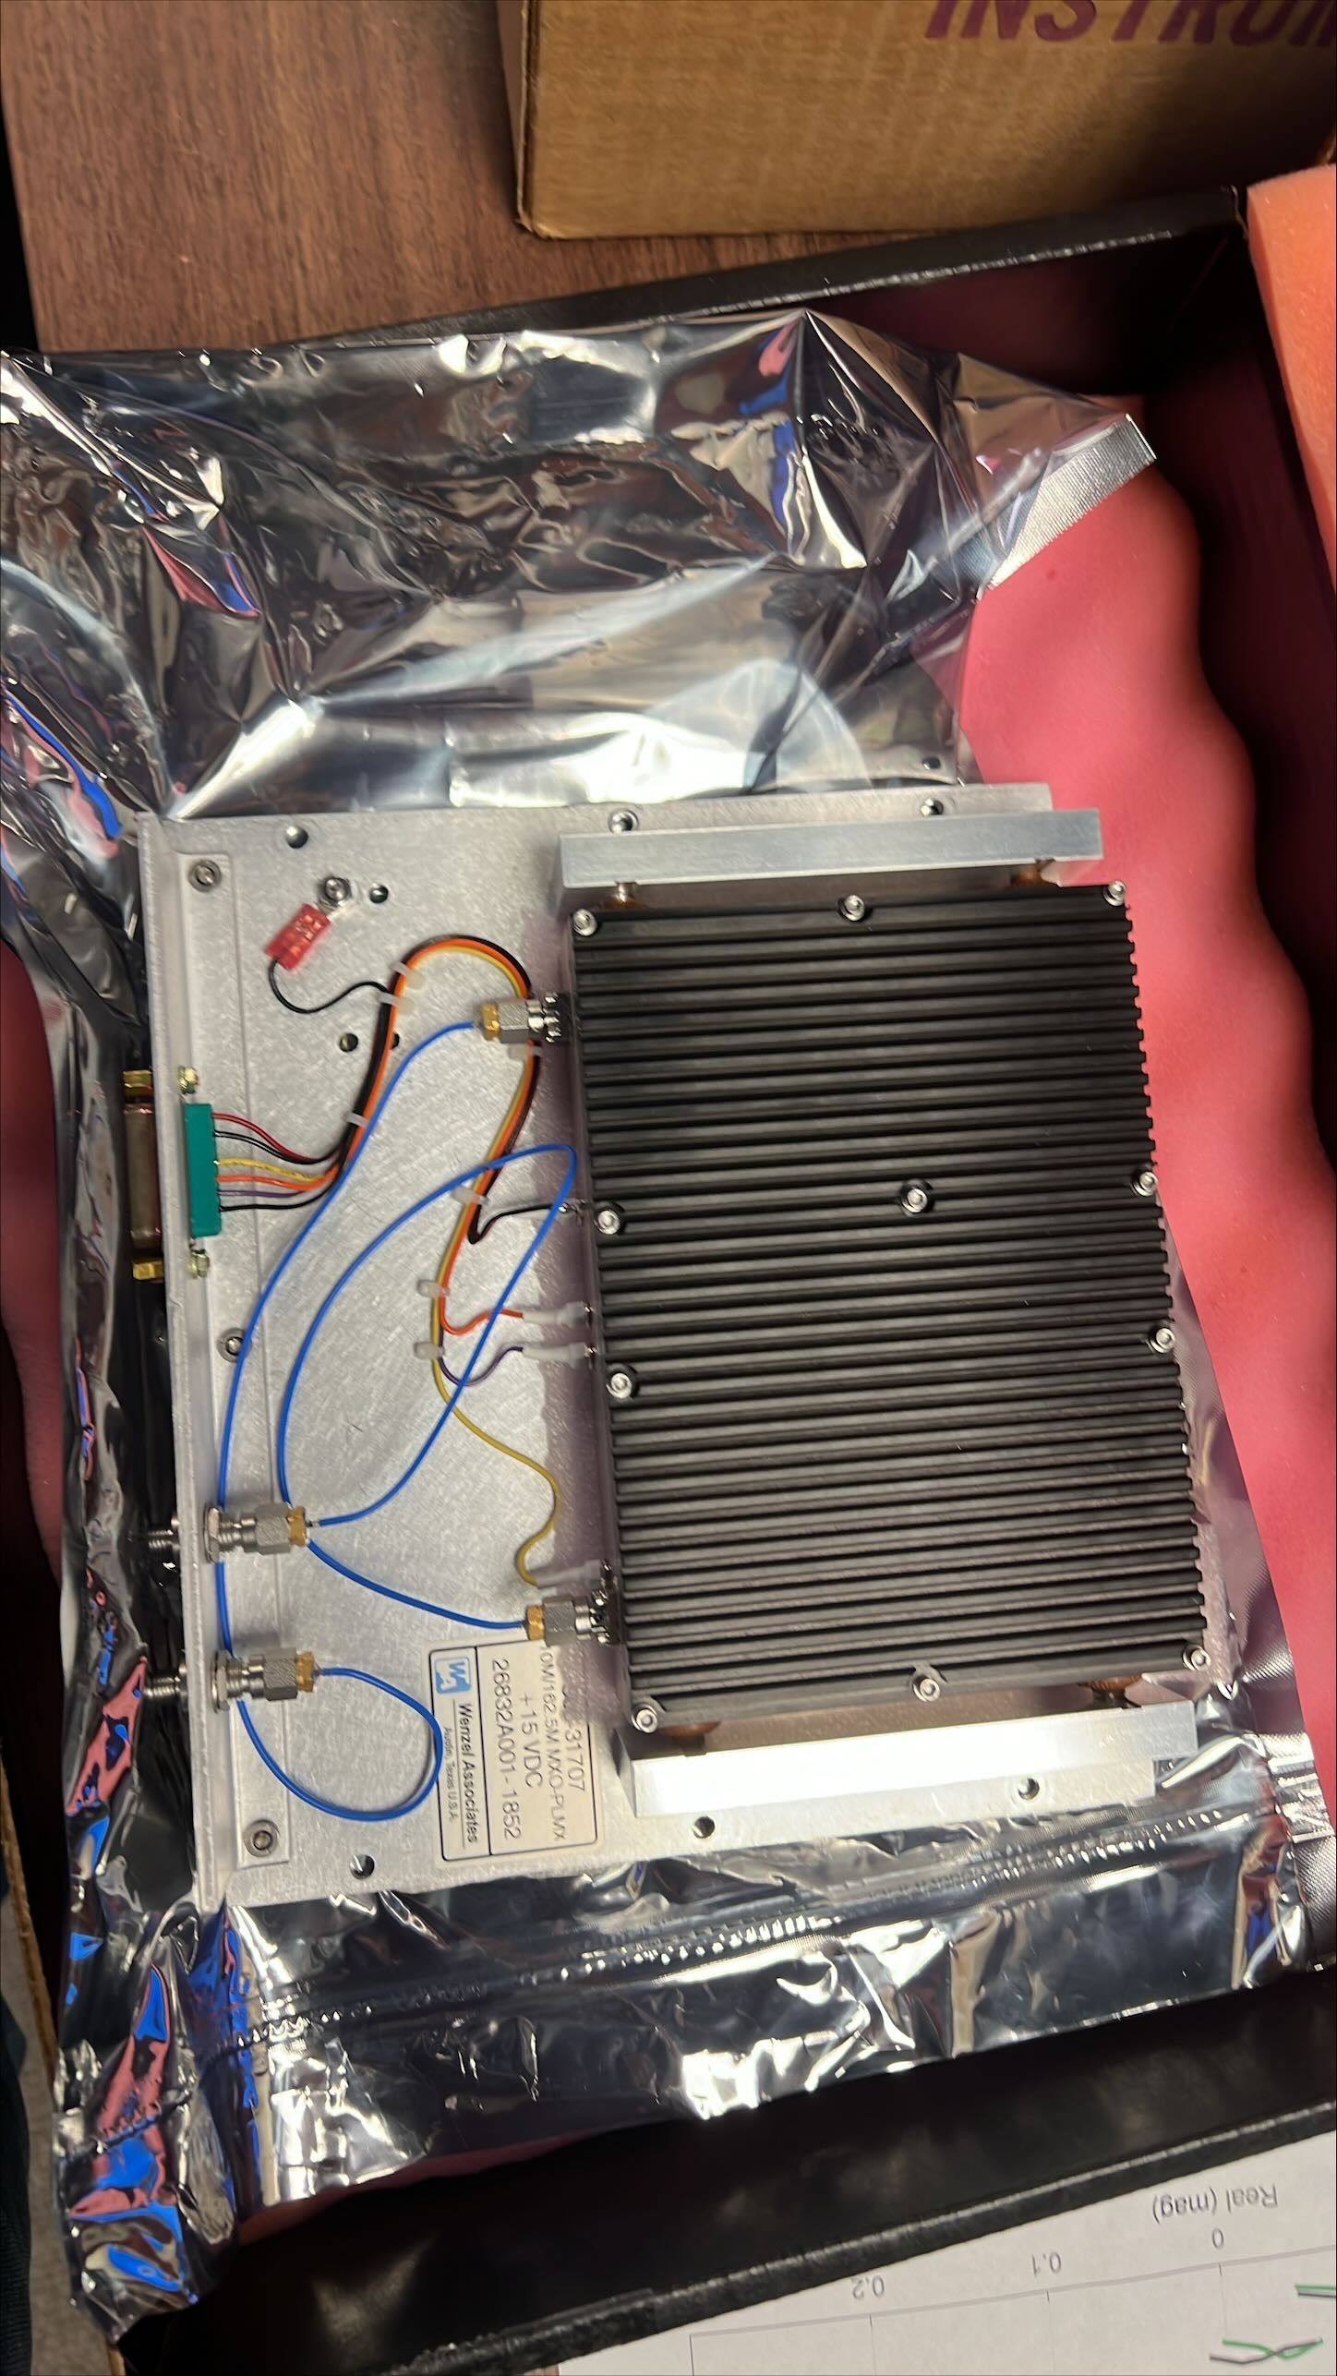
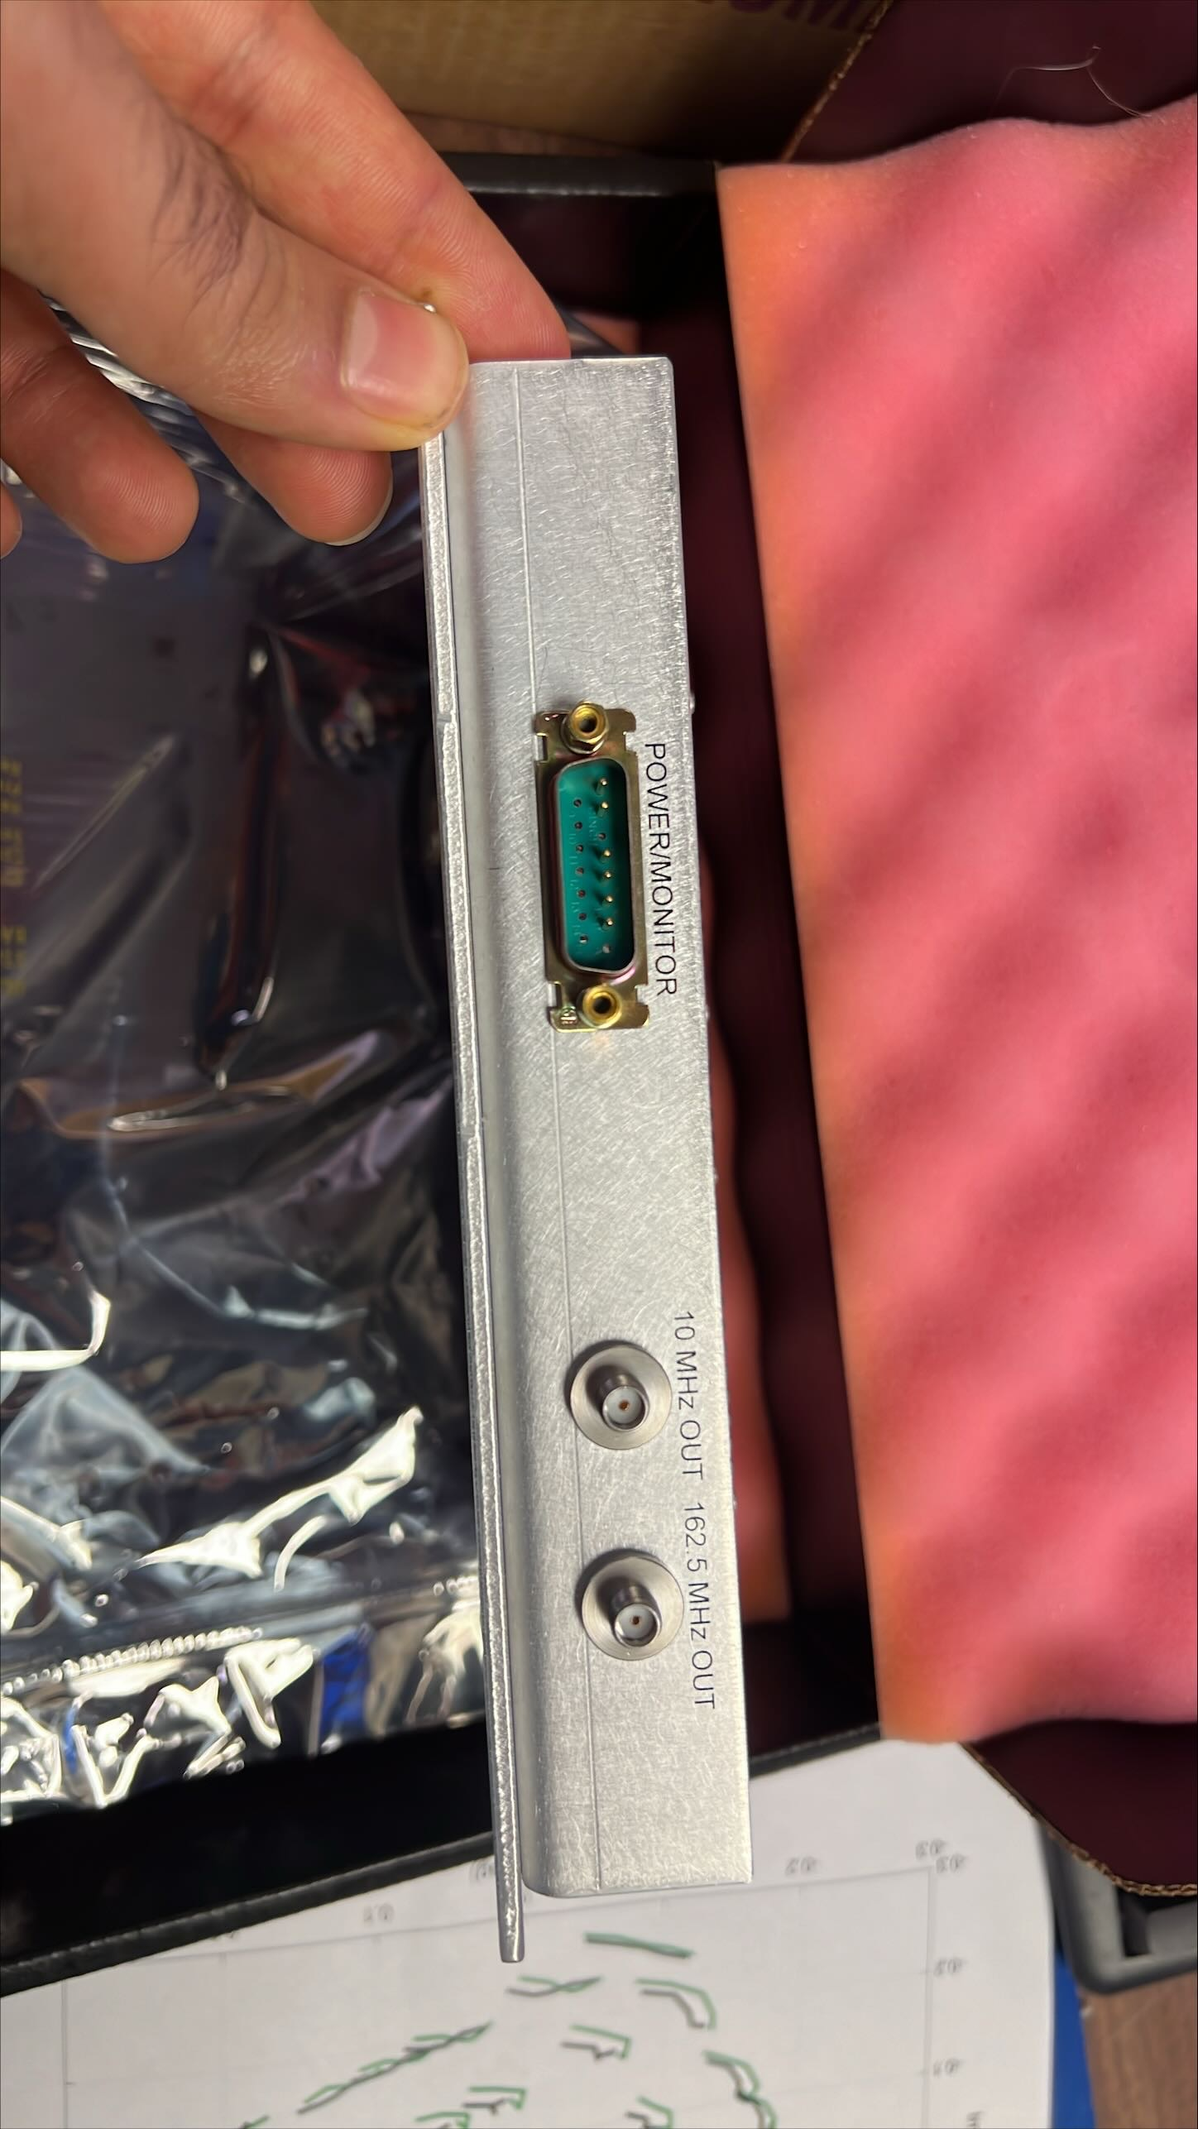
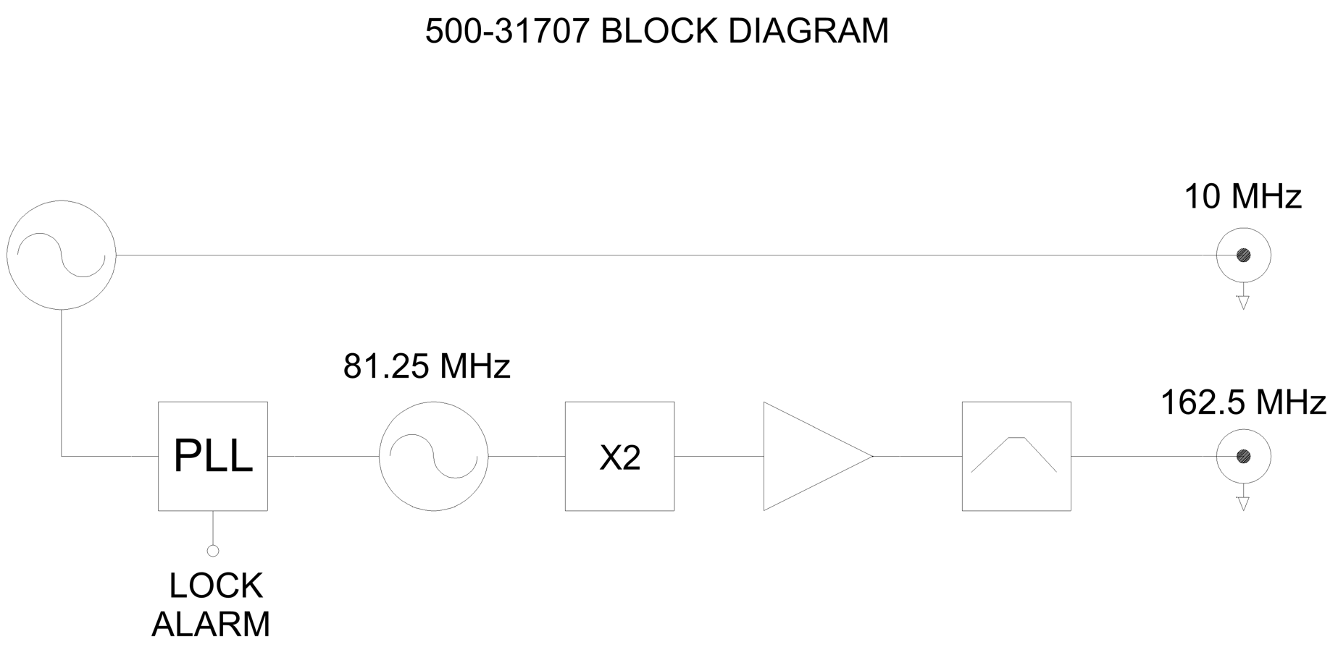
Master Oscillator
162.5MHz &10 MHz Wenzel Vibration Isolated Oscillator MXO-PLMX
The Wenzel MXO-PLMX is a high-performance, vibration-isolated, multiplied crystal oscillator with ultra-low phase noise and frequency stability under dynamic and static conditions. It provides outputs at both 10 MHz and 162.5 MHz, making it ideal for use in precision LLRF reference line system.
10 MHz reference crystal: SC-cut (stress compensated) crystal.
81.25 MHz SC-cut crystal frequency multiplied to generate 162.5MHz output
TTL
Locked: 3.5 to 5.2 VDC(Hi)
Out-of-lock: 0.8VDC max(Lo)
162.5MHz &10 MHz Wenzel Vibration Isolated Oscillator MXO-PLMX
Notes:
Master oscillator is the crux of our system. It is a vibration isolated wenzel plate with two frequency outputs. It has two crystals stress compensated and mounted in a vacuum chamber. The 10MHz is locked with PLL to 81.25 MHz crystal. The 81.25 MHz gets multiplied, amplified and filtered to generate our stable and low phase noise 162.5MHz output.

Slide 12
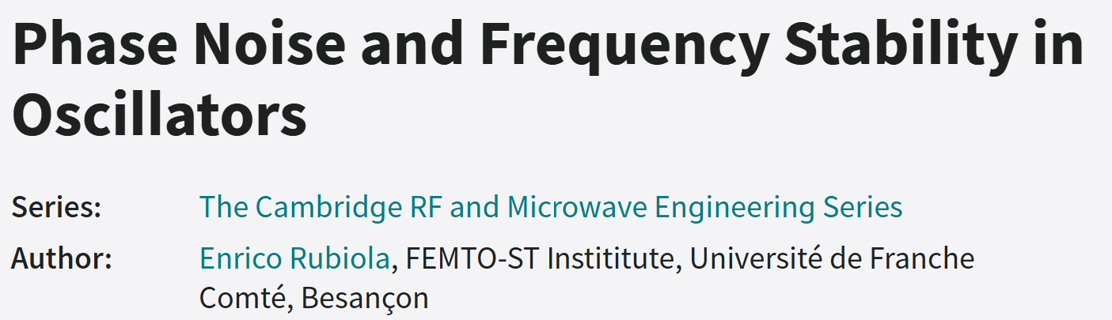
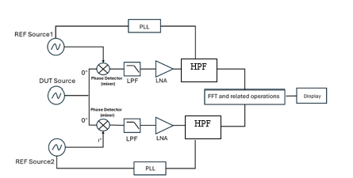
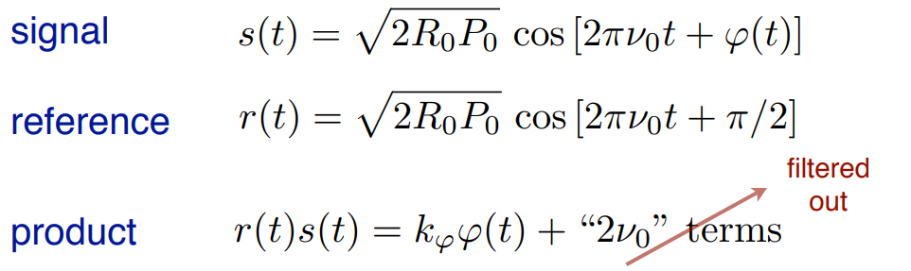
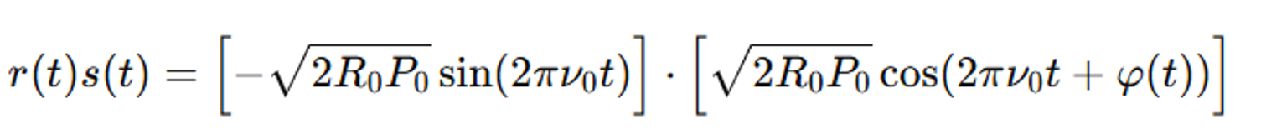
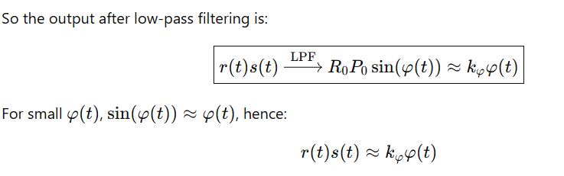
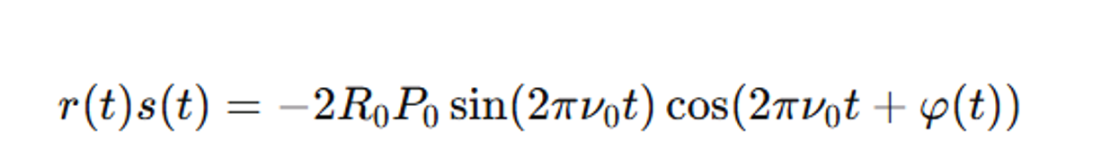
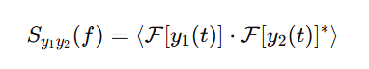
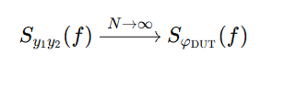
Phase Noise Measurement Details
FERMILAB-SLIDES-25-0272-AD
The RF mixer saturated at both inputs is used as phase detector [7]
Cross –correlation:
N- number of averages
Notes:
We keep saying low phase noise and it offcourse requires an evaluation to prove. With reference to Rubiola’s textbook, we know that the two inputs of a mixer if held at constant frequency and amplitude we prove that the output is a result of phase and amplitude changes which are attributed to the phase noise of the system when higher order modes are filters with high pass. In this technique we measure the correlated noise between two channels using two references which are the same wenzel oscillators. We have 3 of them. By performing cross –correlation, and compensating for mizer slope, amplifier gain and ssb compensation we get the output phase noise.

Slide 13
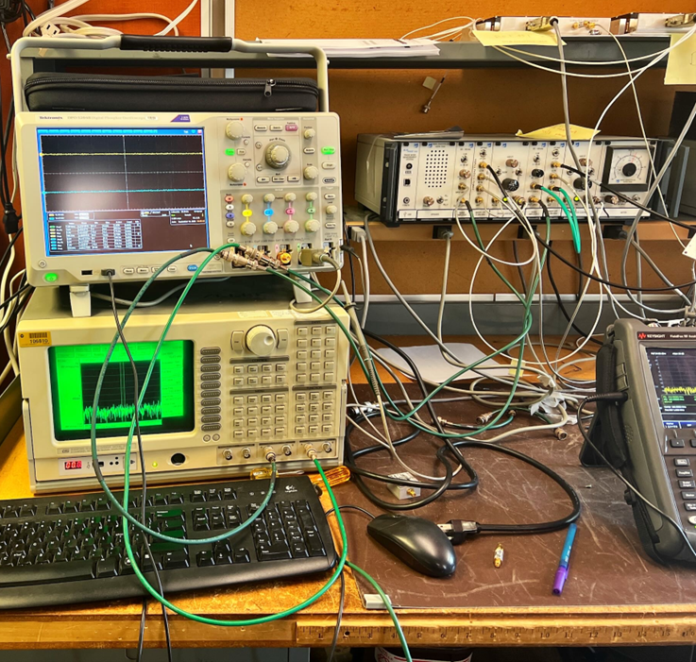
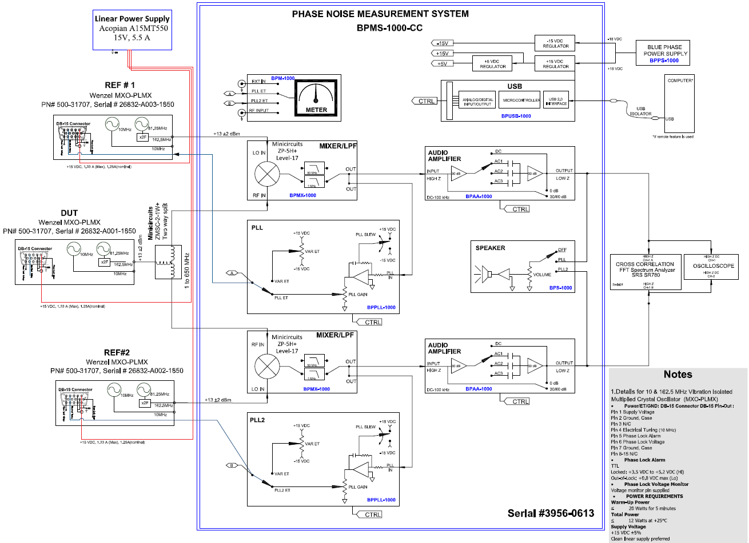
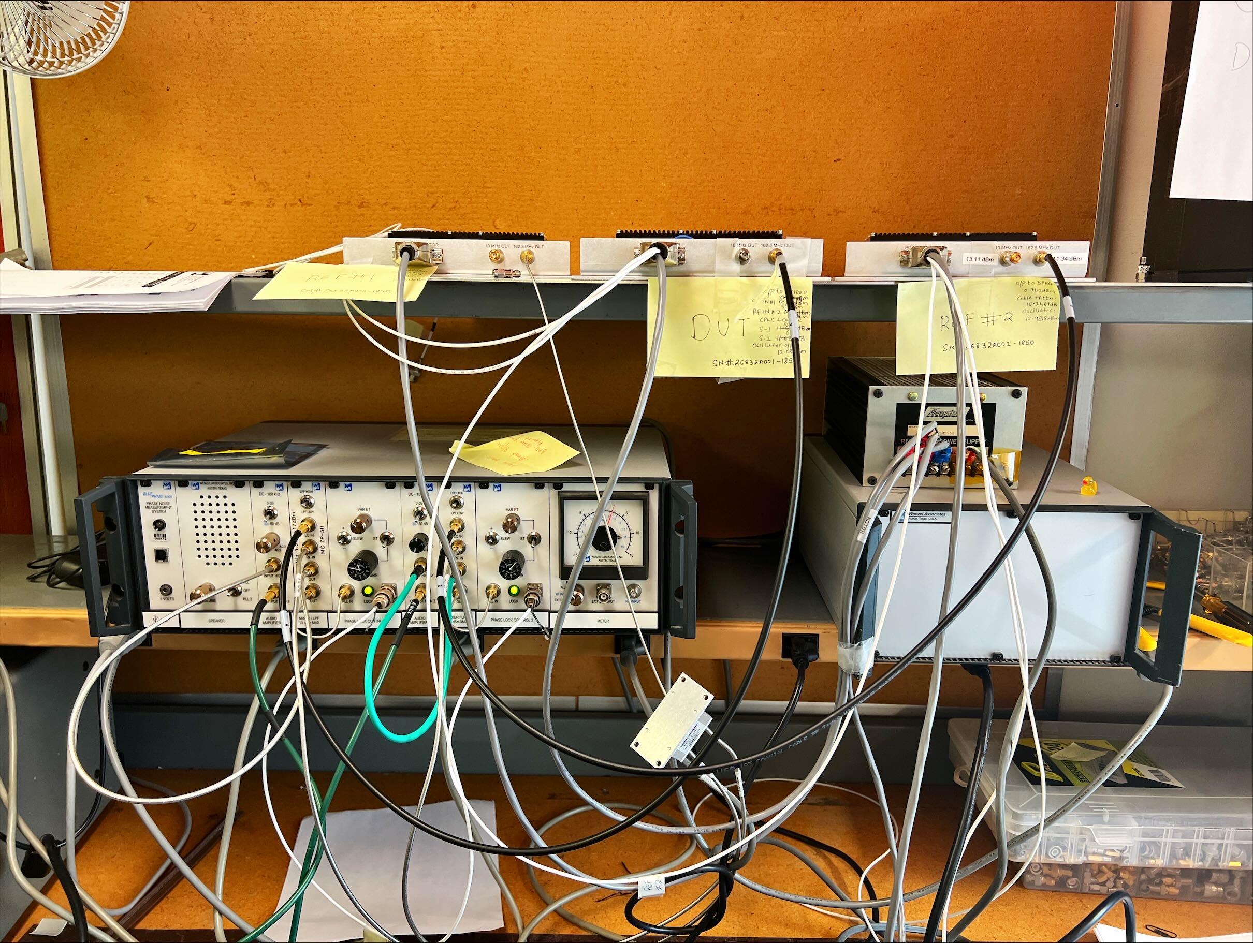
Phase Noise Test Setup Details
FERMILAB-SLIDES-25-0272-AD
Phase Noise Test detailed schematic
Phase Noise Test Setup
SSB Phase Noise of BP-1000C<-190 dBc/Hz at 10 kHz (Typical)
Notes:
So yesterday when we had a talk by Mr. Merenda from minicircuits the importance of good test setup for phase noise measurements was reiterated. The phase noise test setup shown in the screen utilized cables of shortest lengths possible, connections torqued to spec etc. We have a repeatable phase noise measurement system which we can rely on. We use the BluePhase system with phase noise of -190dBc /Hz at 1KHz offset it has a very clean power supply. An SRS 780 analyzer to perform FFT and generate PSD.

Slide 14
Phase Noise Results
FERMILAB-SLIDES-25-0272-AD
162.5MHz RF output Results
PHASE NOISE MEASUREMENTS Serial number# 26832-A001-1850, 26832-A002-1850 and 26832-A003-1850,
Frequency (Hz) | DUT Phase noise of from Wenzel Datasheet L(f) dBc/Hz | Phase Noise L(f) DUT A001 Measured @ Fermi dBc/Hz | Phase Noise L(f) DUT A002 Measured @ Fermi dBc/Hz | Phase Noise L(f) DUT A003 @ Fermi dBc/Hz
10Hz | -109 | -103.74 | -104.55 | -97.69
100Hz | -128 | -137.01 | -132.71 | -131.95
1KHz | -155 | -153.98 | -153.92 | -148.99
10KHz | -175 | -165.16 | -172.16 | -168.16
100KHz | -176 | -179.25 | -177.06 | -171.33
A001: RMS jitter 18.8 fs: 10Hz to 100KHz
A002: RMS jitter 19.4 fs: 10Hz to 100KHz
A003: RMS jitter 36.9 fs: 10Hz to 100KHz
Notes:
Here are the phase noise results or all 3 oscillators we have. The performance is quite staisfaroty. The jitter is integrated by calculating area under the curve for the frequency band and the total jitter is summed to obtain the result in femtosecond for 10Hz to 100KHz.Upon initial tests one of the oscillators was 20-30 dB worse and upon evaluation we discovered a failed vacuum seal in the crystal which was repaired and retested to show conformance.

Slide 15
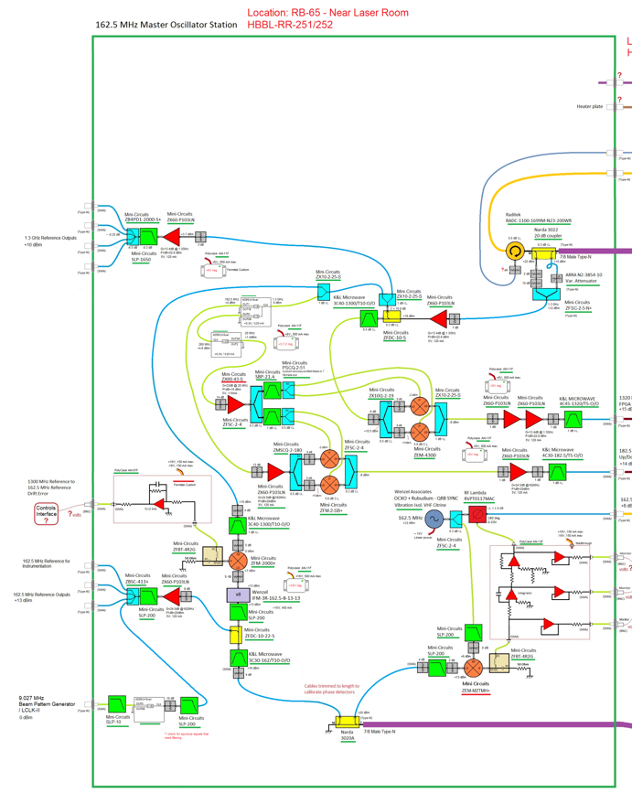
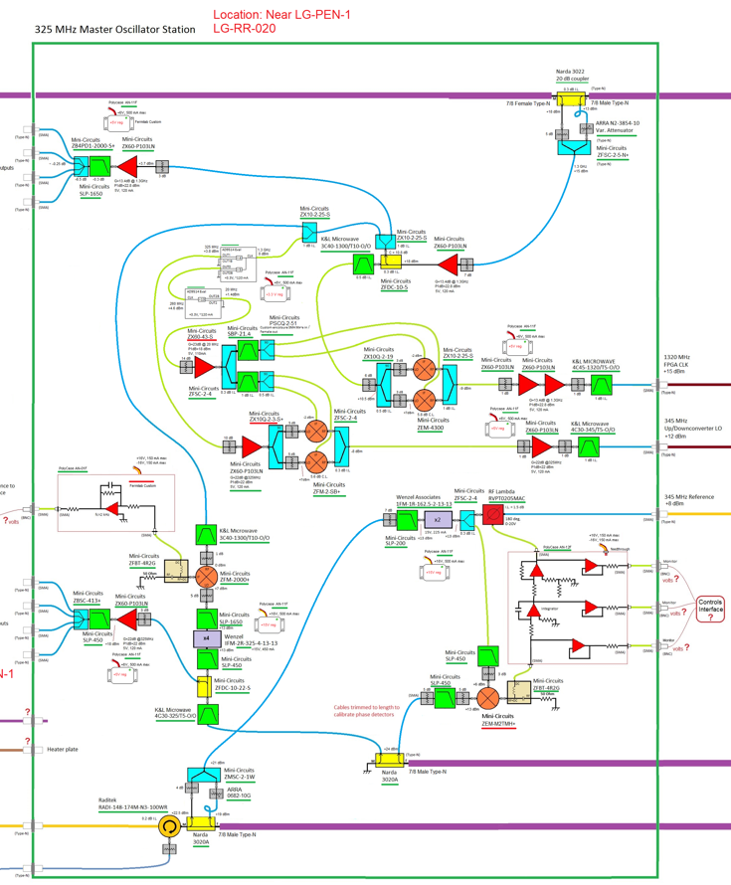
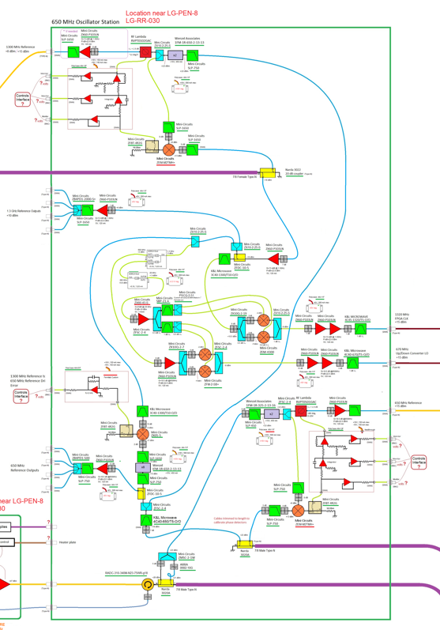
RF components stability
162.5MHz, 325MHz and 650MHz Enclosure – Mounted on 3 separate heat plates
Notes:
RF components are maintained at a stable temperature of 40 degC or 104 F to keep their performance stable over temperature drifts. Like Mixers, amplifiers etc. RF assembly for each frequency section is therefore mounted in an ovenized enclosure and the foot print of the parts are shown on the screen with various connections.

Slide 16
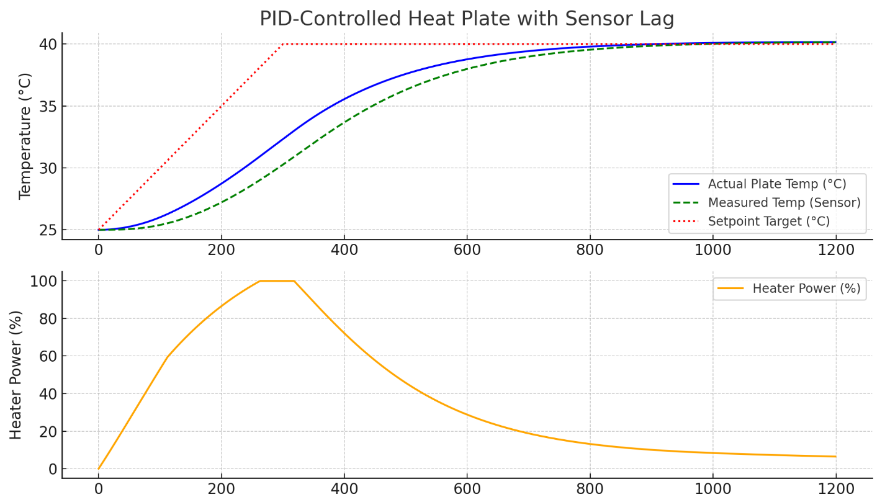
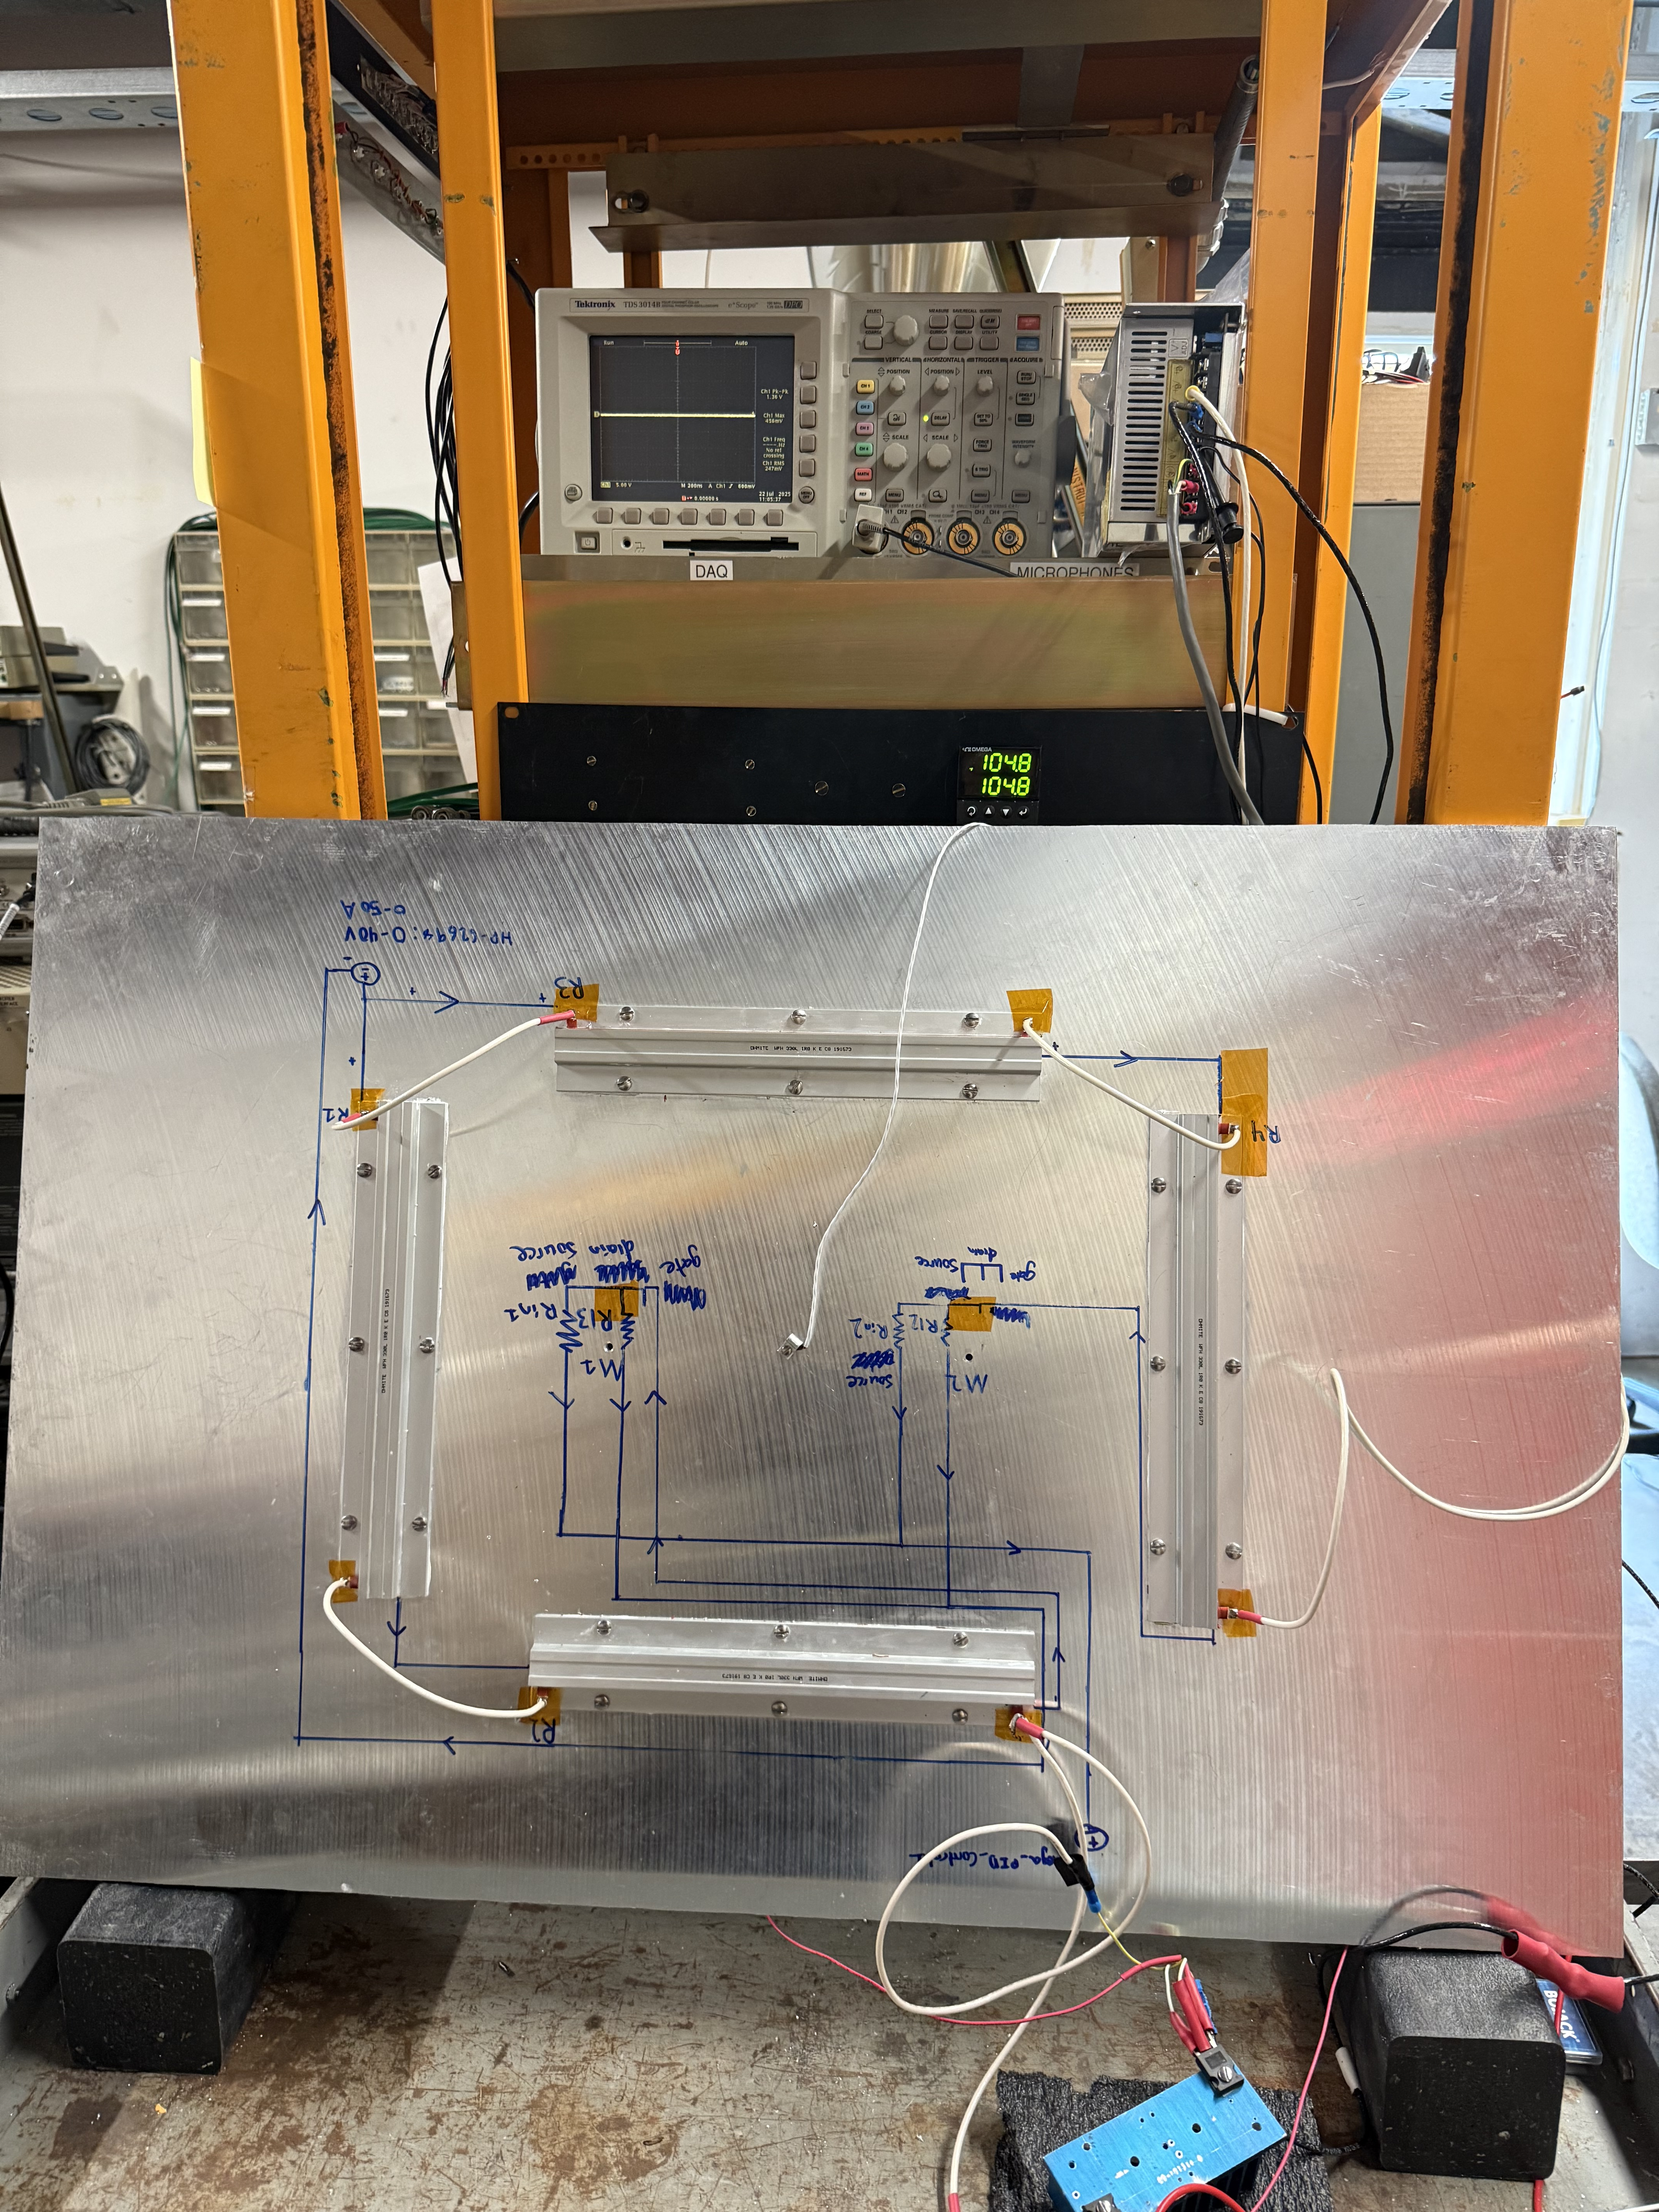
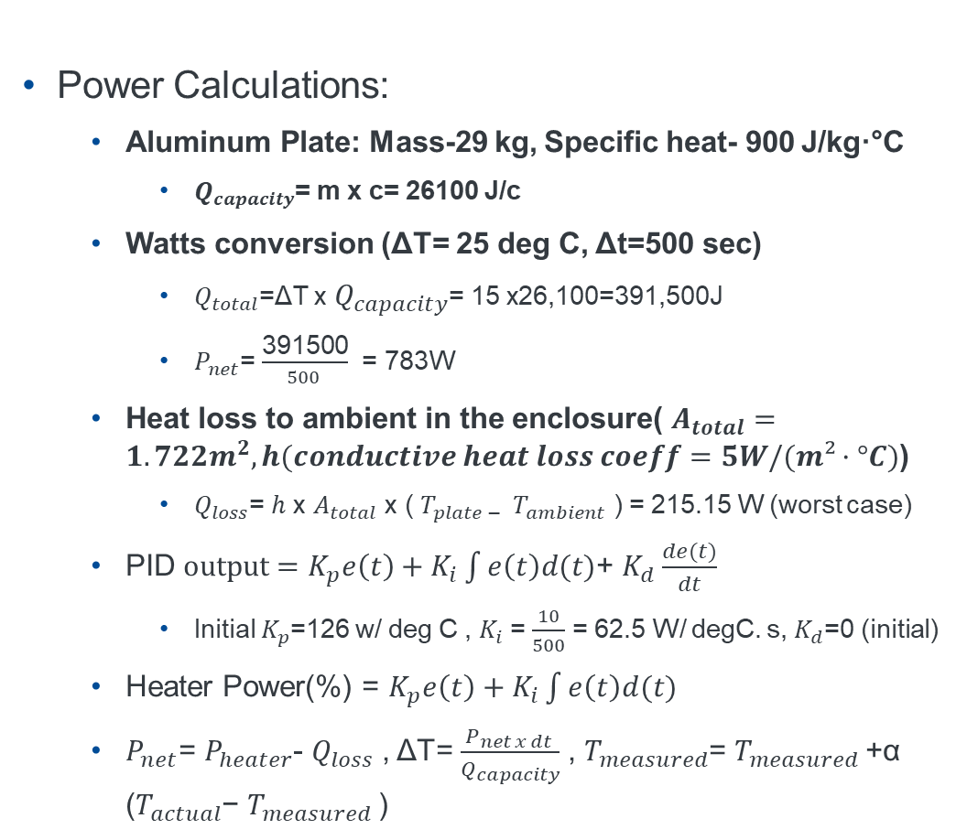
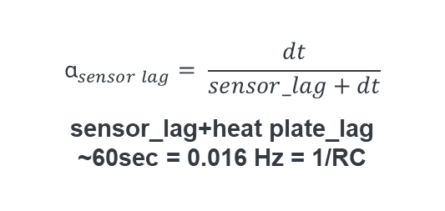
Heat Plate Design and Construction
Power Calculations:
Aluminum Plate: Mass-29 kg, Specific heat- 900 J/kg·°C
$Q_{capacity}$= m x c= 26100 J/c
Watts conversion (ΔT= 25 deg C, Δt=500 sec)
$Q_{total}$​=ΔT x $Q_{capacity}$= 15 x26,100=391,500J
$P_{net}$= $\frac{\text{391500}}{500 }$ = 783W
Heat loss to ambient in the enclosure( $A_{total}=1.722m^{2}, h(conductive heat loss coeff=5W/(m²·°C)$)
$Q_{loss}$= $h$ x $A_{total}$ x ( $T_{plate − }$ $T_{ambient }$) = 215.15 W (worst case)
PID $output=K_{p}e\left(t\right)+K_{i}\int{e\left(t\right)d(t)}$+ $K_{d}\frac{de(t)}{dt}$
Initial $K_{p}$=126 w/ deg C , $K_{i}$ = $\frac{10}{500}$ = 62.5 W/ degC. s, $K_{d}$=0 (initial)
Heater Power(%) = $K_{p}e\left(t\right)+$ $K_{i}\int{e\left(t\right)d(t)}$
$P_{net}$= $P_{heater}$- $Q_{loss}$ , ΔT= $\frac{P_{net x dt} }{Q_{capacity}}$ , $T_{measured}$​= $T_{measured}$+α ($T_{actual}$​− $T_{measured}$​)
$${\text{α}}_{sensor lag}= \frac{dt}{sensor_lag+dt}$$
sensor_lag+heat plate_lag ~60sec = 0.016 Hz = 1/RC
Notes:
Heat plate is designed in house to maintain temperatuet of heat plate to be 40 deg C/ 104 deg F. IT is chosen as a nice favourable level above room temperature in the gallery. RF components will be maintainted at this temperature using a PID controller. We design this by making heat calculations to estimate the heat requirement for heat load in question. A python is used to estimate the temperature performance by accounting for free space heat loss and sensor la

Slide 17
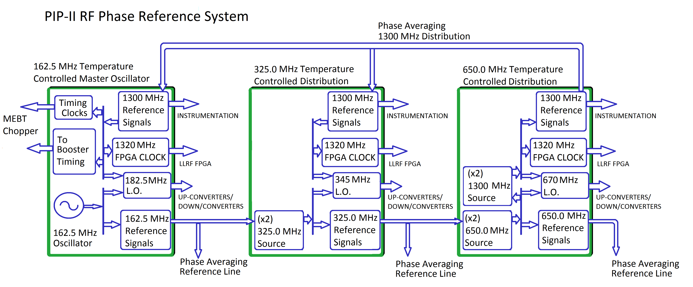
System Architecture
System Health Monitoring on EPIX via Controller or FPGA etc.
Notes:
Slide shows system architecture the RF , LO outputs with monitoring signals. The generation and multiplication scheme is shown more clearly on this slide.

Slide 18
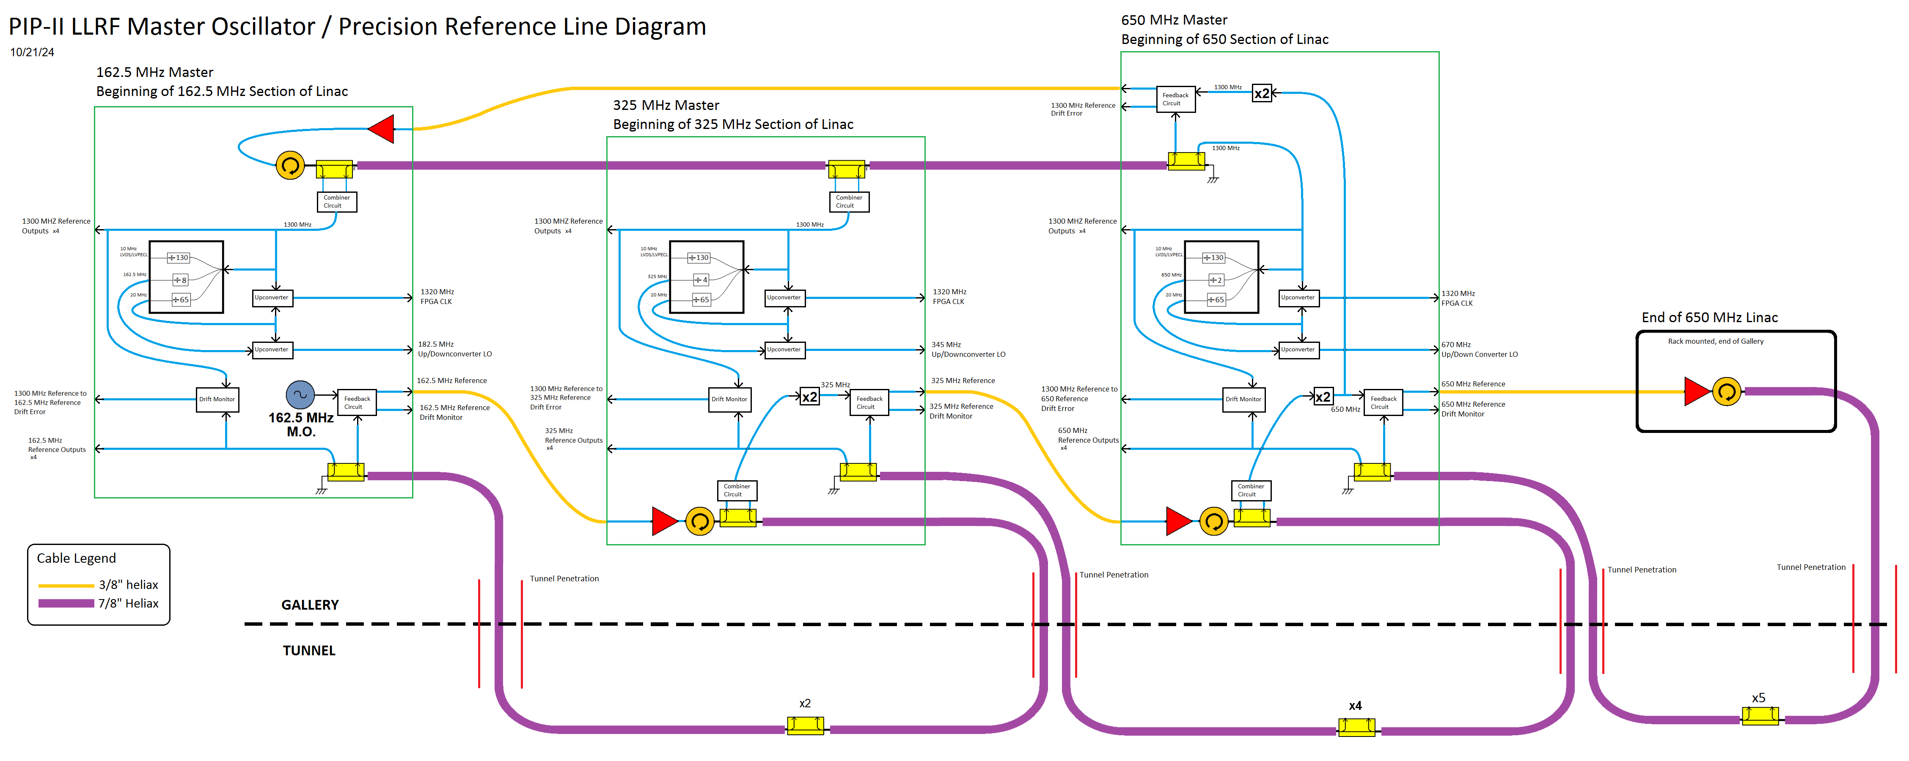
Block Diagram
Notes:
This drawing shows more detailed layout with the 7/8 heliax running through the linac. The multiplication and division of frequencies is shown along with the RF layout of sections

Slide 19

Conclusion
Project Status:
Preliminary design and component testing completed; construction underway to meet PIP-II RF signal requirements.
Core Phase-Stabilization Techniques:
Forward–Reflected Phase Aggregation: Uses shorted line and directional couplers to average forward and reflected signals. → Proven at Fermilab’s 1.3 GHz NML ASTA program.
Active Recirculation: Patent application in review
Performance Verification:
Phase noise and RMS jitter measurements of oscillator confirm compliance with all PIP-II RF specifications.
Bench testing of small-scale prototypes of 1300 MHz sections under thermal cycling agree with simulations.
Next Steps:
Assemble sections of 162.5MHz, 325MHz and 650MHz using scaled cable lengths and perform amplitude matching. Study temperature drifts, phase shifts
Final design, install and commissioning
Notes:
The project has passed preliminary design with final design review scheduled for next year this is about a year of work. Most of parts have been procured and we are actively assembling different portions to be tested soon. The core technique has been proven at New Muon Lab at Fermi and a lot of lessons learnt from that project. We are investigating a new technique for enhanced stability and there is patent filed by Brian Vaughn. Please talk to Brian for more details. The tests and analysis so far indicate we are heading in the right direction and a lot tests to follow till we reach the finish line.

Slide 20

Thank you!

